Slide 1
Spring RESTful Web Services

Slide 2
Contents
Overview of RESTful services
REST implementation options
Creating a Spring RESTful service
Additional mapping techniques
Eclipse project: DemoRESTServices

Slide 3
1. Overview of RESTful Services
The name "REST"
What is a RESTful service?
HTTP verbs
HTTP response codes
Example scenario
Key principles of RESTful services

Slide 4

The Name "REST"
The name “Representational State Transfer” is intended to evoke an image of how a well-designed Web application behaves: a network of Web pages forms a virtual state machine, allowing a user to progress through the application by selecting a link or submitting a short data-entry form, with each action resulting in a transition to the next state of the application by transferring a representation of that state to the user.
Fielding & Taylor 2002

Slide 5
What is a RESTful Service?
REST-based services are resource-centric XML-over-HTTP services
Endpoints (URIs) represent resources
Endpoints are accessible via standard HTTP
Endpoints can be represented in multiple formats, e.g. XML, JSON, RSS, Atom, plain text, HTML, etc.

Slide 6
HTTP Verbs
RESTful services use HTTP verbs to define CRUD-style operations on resources
HTTP verb
Meaning in CRUD terms
POST
Create a new resource from the request data
GET
Read a resource
PUT
Update a resource from the request data
DELETE
Delete a resource

Slide 7
HTTP Response Codes
RESTful services return data, and set a response code to indicate the outcome
HTTP response code
Official HTTP meaning
RESTful meaning
200
OK
Request OK
400
Bad request
Request malformed
403
Forbidden
Request refused
404
Not found
Resource not found
405
Method not allowed
Method not supported
415
Unsupported media type
Content type not recognized
500
Internal server error
Request processing failed

Slide 8
Example Scenario: Overview
The easiest way to understand RESTful services is through an example...
Imagine a hypothetical company that sells many different parts to many customers
The company wants to provide the following Web services:
Get list of parts
Get detailed part information
Submit purchase orders (PO)

Slide 9
Example Scenario: Getting a Part List
The list of parts available from the company is a resource:
A resource is identified via a URI
Resource representations are available via HTTP GET
E.g. GET http://acme.com/parts HTTP/1.1
Gets a representation of the "list of parts" resource
A representation typically contains links to other resources
<?xml version="1.0"?>
<p:Parts xmlns:p="http://www.acme.com" xmlns:xl="http://www.w3.org/1999/xlink">
<Part id="0345" xl:href="http://www.acme.com/part/0345"/>
<Part id="0346" xl:href="http://www.acme.com/part/0346"/>
<Part id="0347" xl:href="http://www.acme.com/part/0347"/>
<Part id="0348" xl:href="http://www.acme.com/part/0348"/>
</p:Parts>

Slide 10
Example Scenario: Getting Part Info
Detailed part info is also a resource identified with a URL
Getting detailed information:
E.g. GET http://www.acme.com/part/0346 HTTP/1.1
Gets a representation of a specific part
How the representation is generated is unspecified
Note: the URIs are logical URIs, not necessarily static pages
<?xml version="1.0"?>
<p:Part xmlns:p="http://www.acme.com" xmlns:xl="http://www.w3.org/1999/xlink">
<Part-ID>0346</Part-ID>
<Name>Widget-A</Name>
<Desc>This part is used within the frap assembly</Desc>
<Spec xl:href="http://www.acme.com/part/0346/spec"/>
<UnitCost currency="USD">0.10</UnitCost>
</p:Part>

Slide 11
Example Scenario: Submitting a PO
To order a part, the client submits a purchase order (PO)
The PO is an XML document
The PO is submitted using standard HTTP POST
A PO is shared information between the company and client
The Web service returns a URI for the submitted PO
The client may delete the PO using HTTP DELETE
<?xml version="1.0"?>
<p:Order xmlns:p="http://www.acme.com" xmlns:xl="http://www.w3.org/1999/xlink">
<Part xl:href="http://www.acme.com/part/0346"/>
<Quantity>10</Quantity>
<Date>2012-10-12</Date>
...
</p:Order>

Slide 12
Key Principles of RESTful Services
RESTful services are based on standard technologies
HTTP, URIs, XML, etc.
But not SOAP!
HTTP verbs specify CRUD operations
POST, GET, PUT, DELETE
Focus on resources
Resource-centric vs. API-centric
Resources are identified using URIs (name everything)
Resources are connected through links (reveal gradually)
Resources may have representations (XML, JSON, HTML, etc.)

Slide 13
2. REST Implementation Options
JAX-RS
Jersey
Deployment options
Other JAX-RS implementations
Spring 3 REST support

Slide 14
JAX-RS
What is JAX-RS?
JAX-RS = Java API for XML RESTful Web services
Specified in JSR 311
JAX-RS is a standard API to simplify creating RESTful Web services
In the javax.ws.rs package
Java annotations to define resources and actions
You use these annotations to decorate your (POJO) RESTful Web service class

Slide 15
Jersey
Jersey is Sun's reference implementation of JAX-RS
Implements all the JAX-RS annotations
Included as a standard part of the GlassFish Application Server
See https://jersey.dev.java.net/

Slide 16
Deployment Options
Deploy to Grizzly lightweight HTTP server (part of Jersey):
Implement a standalone application to host RESTful Web services
Implement RESTful Web services as POJO classes
Deploy to a Java EE application server (e.g. GlassFish)
Create a Java Web application (i.e. WAR file)
In web.xml, configure a servlet to process RESTful requests
Implement RESTful Web services as POJO classes
Web services have full access to Java EE environment

Slide 17
Other JAX-RS Implementations
Restlet
One of the earliest REST frameworks
http://www.restlet.org/
CXF
From Apache
A merger between Celtix and XFire
http://cxf.apache.org/
RESTeasy
From JBoss (but portable to other application servers)
http://www.jboss.org/resteasy/

Slide 18
Spring 3 REST Support
Spring 3 supports RESTful Web services
Doesn't implement JAX-RS
But has more features than JAX-RS
APIs for the service and client
Spring 3 REST integrates seamlessly into Spring MVC
Very familiar programming model
You define controller(s) with methods to handle REST requests
For each method in a controller class, specify:
HTTP method (e.g. GET, POST, etc.)
URI mapping
Path variables (optional)
Request parameters (optional)

Slide 19
3. Creating a Spring RESTful Service
Overview
Project structure
Object marshalling
Supporting XML marshalling
Defining a model class
Defining a simple RESTful controller
Configuring web.xml
Configuring the servlet dispatcher
Issuing a RESTful request

Slide 20
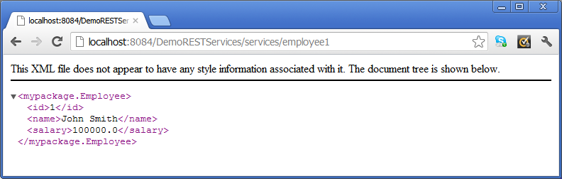
Overview
In this section we'll see how to create a simple RESTful Web service using Spring
The RESTful service will get employee information
E.g. enter the following URL in a browser such as Chrome, to send an HTTP GET request to the server
It will return an Employee object, marshalled as XML (see later)
http://localhost:8084/DemoRESTServices/services/employee1

Slide 21
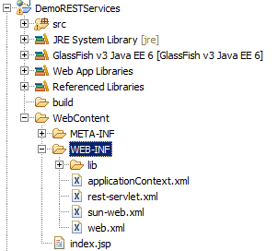
Project Structure
See the DemoRESTServices project
Dynamic Web project, will deploy to GlassFish
Contents of /WEB-INF folder:
web.xml file
As per all Java Web apps
Application context file
As per all Spring apps
Servlet dispatcher config file
As per all Spring Web MVC apps

Slide 22
Object Marshalling
RESTful Web services work perfectly fine with Java objects
E.g. a GET method might return a Java object
E.g. a PUT method might receive a Java object as a parameter
When a Java object is passed back and fore over HTTP, it must be marshalled/unmarshalled into a text-based format
E.g. XML
E.g. JSON
In Spring, you can configure RESTful services so that they know what data formats they need to recognize
We'll see the details during this section

Slide 23
Supporting XML Marshalling (1 of 3)
If you want Java objects to be marshalled as XML...
You must configure a JAXB marshaller/unmarshaller
JAXB = Java Architecture for XML Binding
JAXB provides object-XML marshalling (OXM):
Marshal Java objects to XML
Unmarshall XML to create Java objects
<XML>
marshalling
unmarshalling

Slide 24
Supporting XML Marshalling (2 of 3)
For classes that need to be marshalled to/from XML:
Annotate the class with @XmlRootElement, to enable the class to support JAXB marshalling
Define a no-arg constructor
package mypackage;
import javax.xml.bind.annotation.XmlRootElement;
@XmlRootElement
public class Employee {
private String id;
private String name;
private double salary;
public Employee() {}
// Plus other constructors, getters/setters, and business methods…
}
Optional attributes:
name
namespace
mypackage/Employee.java

Slide 25
Supporting XML Marshalling (3 of 3)
You can fine-tune how fields/properties are to be marshalled:
Annotate fields/properties with @XmlElement / @XmlAttribute
Allowable on non-static, non-transient fields/properties
Object graphs are traversed during marshalling
@XmlRootElement(name="EmployeeRecord")
public class SomeOtherEmployeeClass {
…
@XmlElement(name="EmpName")
public String getName() {…}
public double getSalary() {…}
@XmlElement(nillable=true)
public Date getDateJoined() {…}
@XmlAttribute()
public EmpType getEmpType() {…}
public EmployeeNumber getEmpNumber() {…}
…
}
Optional attributes:
defaultValue
name
namespace
nillable
required
type

Slide 26
Defining a Simple RESTful Controller
Spring 3 REST follows the traditional MVC pattern
Define a controller class, and map methods to RESTful requests
@RequestMapping can specify the following details:
The HTTP method supported by the Java method
The URL pattern that represents this Java method
The HTTP Accept headers satisfied by this Java method
package mypackage;
import org.springframework.web.bind.annotation.RequestMapping;
import org.springframework.web.bind.annotation.RequestMethod;
…
@Controller
public class MySimpleController {
@RequestMapping(method=RequestMethod.GET,
value="/employee1",
headers="Accept=application/json, application/xml")
public Employee getEmployee1() {
return new Employee("1", "John Smith", 100000);
}
mypackage/MySimpleController.java

Slide 27
Configuring web.xml
You configure web.xml as per a standard Spring Web MVC application
<web-app … >
<listener>
<listener-class>org.springframework.web.context.ContextLoaderListener</listener-class>
</listener>
<servlet>
<servlet-name>rest</servlet-name>
<servlet-class>org.springframework.web.servlet.DispatcherServlet</servlet-class>
<load-on-startup>1</load-on-startup>
</servlet>
<servlet-mapping>
<servlet-name>rest</servlet-name>
<url-pattern>/services/*</url-pattern>
</servlet-mapping>
…
/WEB-INF/web.xml

Slide 28
Configuring the Servlet Dispatcher (1 of 2)
You must configure the servlet-dispatcher config file
Use ContentNegotiatingViewResolver to specify the media types supported by your RESTful app
<bean class="org.springframework.web.servlet.view.ContentNegotiatingViewResolver">
<property name="order" value="1" />
<property name="mediaTypes">
<map>
<entry key="xml" value="application/xml"/>
<entry key="json" value="application/json"/>
</map>
</property>
<property name="defaultViews">
<list>
<bean class="org.springframework.web.servlet.view.xml.MarshallingView">
<property name="marshaller">
<bean class="org.springframework.oxm.xstream.XStreamMarshaller" />
</property>
</bean>
<bean class="org.springframework.web.servlet.view.json.MappingJacksonJsonView" />
</list>
</property>
</bean>
Set mediaTypes property to map file extensions to MIME types, to indicate what type to return
E.g. employee1.xml will return XML
E.g. and employee1.json will return JSON
Alternatively, client can set the Accept header
List the view resolvers that will perform marshalling
of Java objects into a suitable format
/WEB-INF/rest-servlet.xml

Slide 29
Configuring the Servlet Dispatcher (2 of 2)
If you're supporting XML marshalling, then you must also configure the JAXB marshaller bean
<bean id="jaxb2Mashaller" class="org.springframework.oxm.jaxb.Jaxb2Marshaller">
<property name="classesToBeBound">
<list>
<!-- Classes returned by MySimpleController (in this Chapter) -->
<value>mypackage.Employee</value>
<value>mypackage.Office</value>
<!-- Classes returned by MyFullController (in next Chapter) -->
<value>mypackage.CatalogItem</value>
</list>
</property>
</bean>
/WEB-INF/rest-servlet.xml

Slide 30
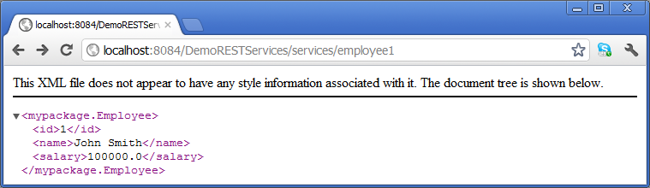

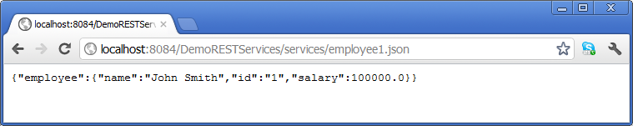
Issuing a RESTful Request
You can issue a RESTful request directly in a browser

Slide 31
4. Additional Mapping Techniques
Mapping path variables
Mapping request parameters
Returning an item from a collection
Returning an entire collection

Slide 32
Mapping Path Variables
You can automatically map parts of the URI to parameters in the operation signature
Allows URIs to represent resources
This is a key RESTful principle
To do this:
In the URI, define {…} placeholder
In the method signature, annotate param with @PathVariable
http://localhost:8084/DemoRESTServices/services/employeePv/1234
@RequestMapping(method=RequestMethod.GET, value="/employeePv/{id}",
headers="Accept=application/json, application/xml")
public Employee getEmpViaPathVariable(@PathVariable String id) {
return new Employee(id);
}
mypackage/MySimpleController.java

Slide 33
Mapping Request Parameters
You can also automatically map HTTP request parameters to parameters in the operation signature
Useful for optional information
You can also specify a default value if you like
To do this:
In the method signature, annotate param with @RequestParam
http://localhost:8084/DemoRESTServices/services/employeeRp?id=5
@RequestMapping(method=RequestMethod.GET, value="/employeeRp",
headers="Accept=application/json, application/xml")
public Employee getEmpViaRequestParam(@RequestParam(value="id",
required=false,
defaultValue="1234") String id) {
return new Employee(id);
}
mypackage/MySimpleController.java

Slide 34
Returning an Item from a Collection
This example shows how to return one item from a collection
private List<Office> populateOffices() {
List<Office> offices = new ArrayList<Office>();
offices.add(new Office("England", "London"));
offices.add(new Office("France", "Paris"));
offices.add(new Office("USA", "New York"));
offices.add(new Office("Norway", "Tromso"));
offices.add(new Office("Wales", "Swansea :-)"));
return offices;
}
@RequestMapping(method=RequestMethod.GET, value="/office",
headers="Accept=application/json, application/xml")
public Office getOffice(@RequestParam(value="index",
required=false,
defaultValue="0") int index) {
List<Office> offices = populateOffices();
if (index < 0 || index >= offices.size())
index = 0;
return offices.get(index);
}
mypackage/MySimpleController.java

Slide 35
Returning an Entire Collection
This example shows how to return an entire collection
@RequestMapping(method=RequestMethod.GET, value="/offices",
headers="Accept=application/json, application/xml")
public List<Office> getAllOffices() {
return populateOffices();
}
mypackage/MySimpleController.java

Slide 36
Summary
Overview of RESTful services
REST implementation options
Creating a Spring RESTful service
Additional mapping techniques
Additional technique: Object-XML Mapping
See DemoOXM project

Slide 37
Any Questions?

